Slide 1
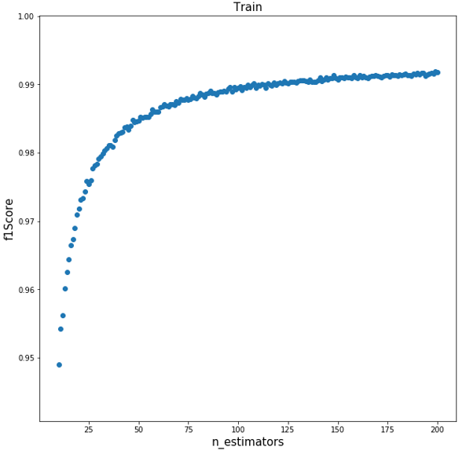
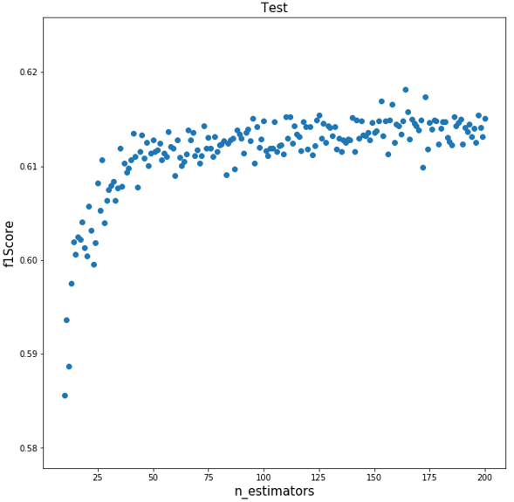
개발과정
rows
max_features
min_samples_leaf
max_leaf_nodes
max_depth
338,022
‘auto’
1
None
None

